Slide 1

Area, Surface Area and Volume
Choose...
AREA
(Flat Shapes)
SURFACE AREA
(3-d shapes)
VOLUME
(3-d shapes)
CONVERSION
OF UNITS

Slide 2
Part 1
Areas of flat shapes
Basic areas – 2d shapes

Slide 3
Areas of flat shapes
Rectangle (including Square)
Triangle
Circle
Parallelogram (including rhombus)
Trapezium
All area measurements are in square units e.g. cm², m², km², mm²
This is because area is 2-DIMENSIONAL

Slide 4
1.1a: Rectangles
L
B
Area = L × B

Slide 5
1.1b: Squares (special case of rectangles)
S
S
Area = S × S = S²

Slide 6
1.2: Triangles
H
H
B
B
Area = ½ ×B × H or (B × H)/2
Important!! The “B” and “H” MUST be perpendicular to each other – they must meet at 90°

Slide 7
Calculate the area of these triangles?
½ × 17 × 10 = 85 m²
8m
15m
10m
17m
Use only the two measurements that are at right angles to each other!
7m
17m
9m
12m
½ × 12 × 7 = 42 m²

Slide 8
1.3: Circles
R
Area = π r ²
Don’t confuse this with the formula C = 2 π r, which gives circumference (perimeter)

Slide 9
1.4: Parallelograms
H
B
Area = B × H
Important! Like in triangles, the B and H must be at right angles (perpendicular). H is the Perpendicular Height, NOT distance up the side!

Slide 10
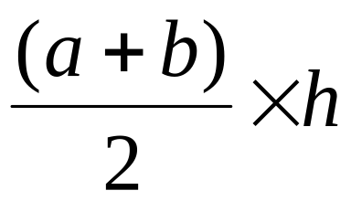
1.5: Trapeziums
a
h
b
For these, you need 3 measurements....
“a”, one of the two parallel sides
“b”, the other parallel side
“h”, the perpendicular height
Area =

Slide 11
Now try these – find the areas of each shape
1
2
7 m
7m
10 m
18m
9 m
4.
3
8m
7 m
20m
12 m
Ans + method

Slide 12
5.
6.
12m
4m
5m
6m
7.
1.5m
3m
Find the white area on this Japanese flag
5m
Ans + method

Slide 13
Part 2
Total Surface Area
of 3-d shapes

Slide 14
Learn the formulae in this section
Shape | TSA Formula
Prisms | TSA = total area of all faces Rectangular Prism: 6 faces (if closed) Triangular Prism: 5 faces (if closed)
Cylinders | TSA = 2 π r h (for the curved wall) + π r² for each circular end if there is one
Spheres | TSA = 4 π r²
Cones | TSA = π r L (for the curved wall) + π r² for the circular base if there is one
Pyramids | TSA = Base area + area of the triangular sides.These can be tricky – you may need Pythag to work out height of sloping faces!
May need Pythag to find L

Slide 15
2.1: TSA of a rectangular prism or cube
6m
7m
8m

Slide 16
Cut the box up into its 6 faces
8m
Front & Back.
6m
2 of these, so SA
= 2 × 8 × 6 = 96 m²
8m
Top & Bottom.
7m
2 of these, so SA
= 2 × 8 × 7 = 112 m²
7m
Left & right.
6m
2 of these, so SA
= 2 × 6 × 7 = 84m²
TSA = 96 + 112 + 84 = 292m²

Slide 17
2.2: TSA of a Cylinder
3 types
r
h
Nº 1
Nº 2
Nº 3
h
Closed both ends –
3 surfaces
Closed one end –
2 surfaces
Open both ends –
1 surface
1 curved wall
2 circles
1 curved wall
1 circle
The curved wall only

Slide 18
Finding the formula for the area of curved wall
r
C=2πr
r
h
h

Cut it up the side. The red circumference (2πr) above becomes the red length below
Begin with an open-ended cylinder
2πr
h
Area = 2πrh

Slide 19
Example – find the surface area of this cylinder closed at one end....
3 cm
We have two areas...
8 cm
Base
Curved wall
A = π r²
A = 2πrh
= π × 3²
= 2π × 3 × 8
= 150.80 cm²
= 28.27 cm²
Total = 28.27 + 150.80 = 179.07cm²

Slide 20
2.3: TSA of a Cone
2 types
Closed cone
Open cone
2 surfaces
1 surface
Curved wall +
Base
Curved wall
Only

Slide 21
Cones - formulae
L
r
Area of the curved wall = π r L
L is called “slant height”

Slide 22
Example – find the surface area of this closed cone
9 cm
Two areas:
4cm
Circular base
Curved wall
A = π r²
A = π r L
= π × 4²
= π × 4 × 9
= 50.265 cm²
= 113.097 cm²
TSA = 50.265 + 113.097 = 163.362 cm²

Slide 23
Refresher – Pythagoras’s Rule
c² = a² + b² if you want the longest side
c
a
OR...
b
b² = c² – a² if you want one of the two shorter sides
Example…..
4 m
Finding the longest side so use the top formula
3 m
x² = 3² + 4²
x m
x² = 25
x = 5

Slide 24

Another cone example. Find the TSA of this open cone
TSA = π r L
Note – we have a problem as we don’t know the slant height L
=13
L
12cm
But we DO have a right angled triangle made by L, 5 and 12!!
5cm
Pythag!
L² = 5² + 12²
L² = 169
L = 13 cm
TSA = π r L = π × 5 × 13 = 204.2 cm²

Slide 25
2.4: TSA of a Sphere
r
TSA = 4 π r²
Example
TSA = 4πr²
Note r = 5
= 4π × 5²
10cm
= 314.16 cm²

Slide 26
2.5: TSA of a Pyramid
Rectangular-based pyramids (closed) have five faces:
(1) a base – only one of these!
(2) a front & back triangular side (same size)
(3) a left & right triangular side (same size)
If it’s a square based pyramid, all 4 sides are the same size!

Slide 27
Example 1 – Find TSA of this closed pyramid
Perp ht from centre of base is 12cm
Square base of side 10cm
Perp ht. of each of the 4 sloping triangles is 13cm (this is actually a sloping length)
12cm
13cm
10cm
10cm
BASE:
10 × 10 = 100 cm²
EACH Δ:
½ 10 × 13 = 65 cm² (4 of these remember)
TSA:
100 + (4 × 65) = 360 cm²

Slide 28
Example 2 – (Extension). Find the TSA of this pyramid
A
3
B
C
G
6
E
8
D
5 surfaces:
(1) : Floor is 8 x 6 = 48 (easy!)
(2 & 3) : Right and left Δs ADC and ABE.
(4 & 5) : Front and back Δs ADE and ACB.
First let’s work out the area of triangle ADC (which will be the same as the one opposite it – ABE). We know its base is 6, but its perp. Height AG we have to find!!

Slide 29
A
?
3
B
C
6
F
4
G
A
E
8
D
Draw the triangle AFG.
3
x
This will help us find AG, which is the perp. height of triangle ADG
4
F
G
½ × 8 = 4
Use Pythag:
x² = 3² + 4²
x² = 25
x = 5

Slide 30
A
A
3
5
B
C
6
F
G
5
E
8
D
D
G
C
6
Area of face ADC
= ½ × BASE × PERP HT
= ½ × 6 × 5
= 15 cm²
This is also area of opposite side AEB

Slide 31
A
3
B
C
F
6
H
E
8
D
Now we work out the area of the front face triangle AED (same as ABC)
We know its base ED = 8
but need to work out perp height AH
Draw triangle AFH, where F is again mid-base and angle AFH is 90°. FH will be ½ of DC, i.e. 3.

Slide 32
A
A
x
3
3
x
B
C
6
H
F
E
8
D
3
F
H
This will help us find AH, which is the perp. height of sloping triangle ADG
Use Pythag:
x² = 3² + 3²
x² = 18
x = 4.24

Slide 33
A
4.24
3
B
C
6
E
8
D
Area of face ADE
= ½ × BASE × PERP HT
= ½ × 8 × 4.24
= 16.96 cm²
This is also area of opposite side ABC
So, TSA = Right side + left side + front + back + floor
= 2 × 15 + 2 × 16.96 + 48
= 111.92 cm²

Slide 34
Summary of formulae in preceding section
Shape | TSA Formula
Prisms | TSA = total area of all faces Rectangular Prism: 6 faces (if closed) Triangular Prism: 5 faces (if closed)
Cylinders | TSA = 2 π r h (for the curved wall) + π r² for each circular end if there is one
Spheres | TSA = 4 π r²
Cones | TSA = π r L (for the curved wall) + π r² for the circular base if there is one
Pyramids | TSA = Base area + area of the triangular sides.
NEXT SECTION

Slide 35
Answers to areas questions (Slide 10 & 11)
No | Approach | Ans
1 | ½ x b x h = ½ x 10 x 7 | 35m²
2 | Area ½ circle is ½ π r² = ½ x π 3.5² | 19.24m²
3 | Area trapezium is ½ (a + b) x h = ½ x (9 + 12) x 7 | 73.5m²
4 | Split into 2 smaller rectangles with line down the middle: Left rectangle is 8 x 9 and right rectangle is 9 x 20. Note the unlabelled lengths are both ½ of 18 ie 9 | 252m²
5 | Area of a ¼ circle is ¼ π r² = ¼ x π x 4² | 12.57m²
6 | Rectangular base = 6 x 5 = 30. Triangle top part = ½ x 6 x 7 = 21. Total 30 + 21 | 51m²
7 | Note circle’s radius is 1m. Area rectangle = 3 x 5 = 15. Circle = π r² = 3.14. Now subtract 15 – 3.14 | 11.86m²
Back

Slide 36
Part 3
Volume
of 3-d shapes

Slide 37
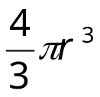
Summary of formulae in this section
Shape | Volume Formula
All prisms Rectangular Prism Triangular Prism Trapezoidal prism Cylinder Cube | Volume = Area of Base × Perp Ht For a rectangular prism, V = LBH For a cube, V = S³ For a cylinder, V = πr²h
“Pointies” Cones Pyramids | Volume = 1/3 × Area of Base × Perp Ht
Spheres | Volume =
All volumes are in cubic units – m³. cm³, mm³
Because Volume is 3 – DIMENSIONAL!

Slide 38


3.1: Volume of a Prism
Prisms are shapes that have a pair of identical, parallel ends (the “base” and top)
and straight sides (the “height”) perpendicular to the base.
Any cut (called a cross-section) made through the shape parallel to the top or base will result in exactly the same shape as the base or the top.

HEIGHT
BASE
Volume of any prism =
Base Area x Perpendicular Height

Slide 39
These are all prisms…..
Can you pick the base and height?
Height
Height
Base can be any face.
Base
Base
Height
Height

Slide 40
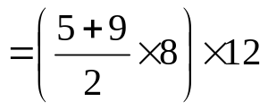
3m
4m
5m
5m
7m
12m
Vol = Base Area × Perp Ht
NOTE!! The base is the Δ front and height is 7
= 5 × 4 × 3
Vol = Base Area × Perp Ht
= 60 cubic metres
= (½ × 12 × 5) × 7
= 210 m³
8cm
9cm
Note! r = 2
5cm
12cm
5cm
Note! Base is front trapezium & height is 12
4cm
Vol = Base Area × Perp Ht
Vol = Base Area × Perp Ht
= π × 2² × 5
= 62.83 cm³
= 672 cm³

Slide 41

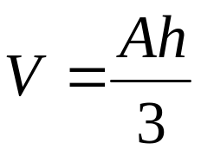
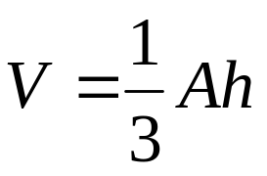
Cones
Pyramids
Perp. Ht
h
Base area
A
Volume of any pointed shape
or

Slide 42
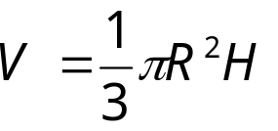
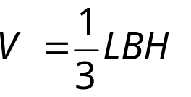
3.2: Volume of a “Pointy” shape : Cones and Pyramids
H
H
B
L
Base = πR ²
Base = L x B
V = 1/3 × base area × perp ht
V = 1/3 × base area × perp ht

Slide 43
Examples : Cones and Pyramids
8cm
9m
5cm
8m
10m
V = 1/3 × base area × perp ht
V = 1/3 × base area × perp ht
= 1/3 × π × 5² × 8
= 1/3 × 10 × 8 × 9
= 209.44 cm³
= 240 m³

Slide 44
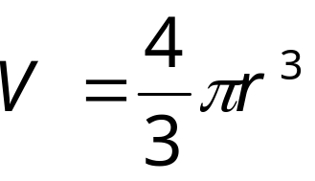
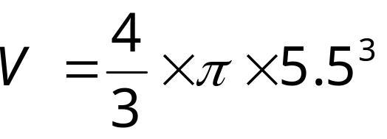

3.3: Volume of a Sphere
11cm

Slide 45
Summary of formulae in this section
Shape | Volume Formula
All prisms Rectangular Prism Triangular Prism Trapezoidal prism Cylinder Cube | Volume = Area of Base × Perp Ht For a rectangular prism, V = LBH For a cube, V = S³ For a cylinder, V = πr²h
“Pointies” Cones Pyramids | Volume = 1/3 × Area of Base × Perp Ht
Spheres | Volume =
All volumes are in cubic units – m³. cm³, mm³
Because Volume is 3 – DIMENSIONSAL!

Slide 46
Special conversions you need to know
Length measure
1-dimension
Area/TSA measure
2-dimensions
Volume measure
3-dimensions
100cm = 1m
10 000cm² = 1m²
1 000 000cm³ = 1m³
1000mm = 1m
1 000 000mm² = 1m²
10⁹ mm³ = 1m³
10mm = 1cm
100mm² = 1cm²
1000mm³ = 1cm³
1000m = 1km
1 hectare = 10000m²
CAPACITY
1 litre = 1000cm³
1m³ = 1000 litres
1cm³ = 1 mL

Slide 47
Proving the formula for curved surface area of a Cone, i.e.
TSA = π R L
L
L
L
R

2πR

Slide 48
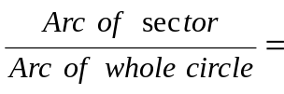
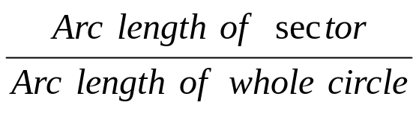
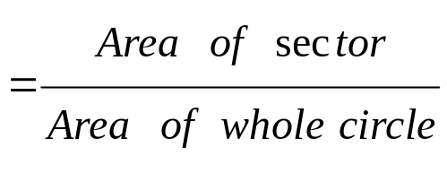
Comparing the sector area with the whole circle
L
L
We want to find this area. Call it S
Area = πL²
Arc length = 2πL
2πR
Because they are part of the same circle we can say that the two arc lengths and the two areas are in proportion

Slide 49
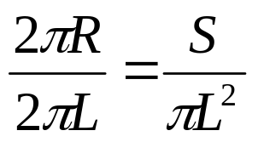
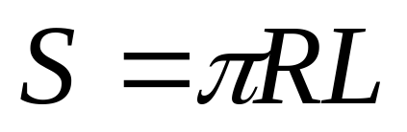
L
L
We want to find this area. Call it S
Area = πL²
Arc length = 2πR
Arc length = 2πL
cross-multiply
2πLS = 2π²RL²

